Slide 1
Case study on sql queries in AMAZON
Presented by
Mr. sujitkumar dasharath amrute

Slide 2

* DATABASE OPERATIONS –
To create database : create database Amazon;
To use database : use amazon;

Slide 3
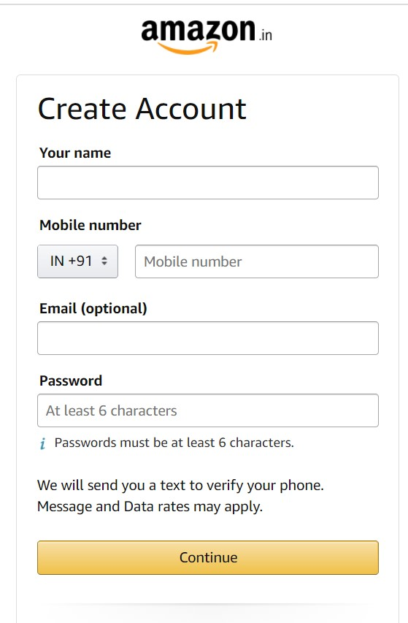
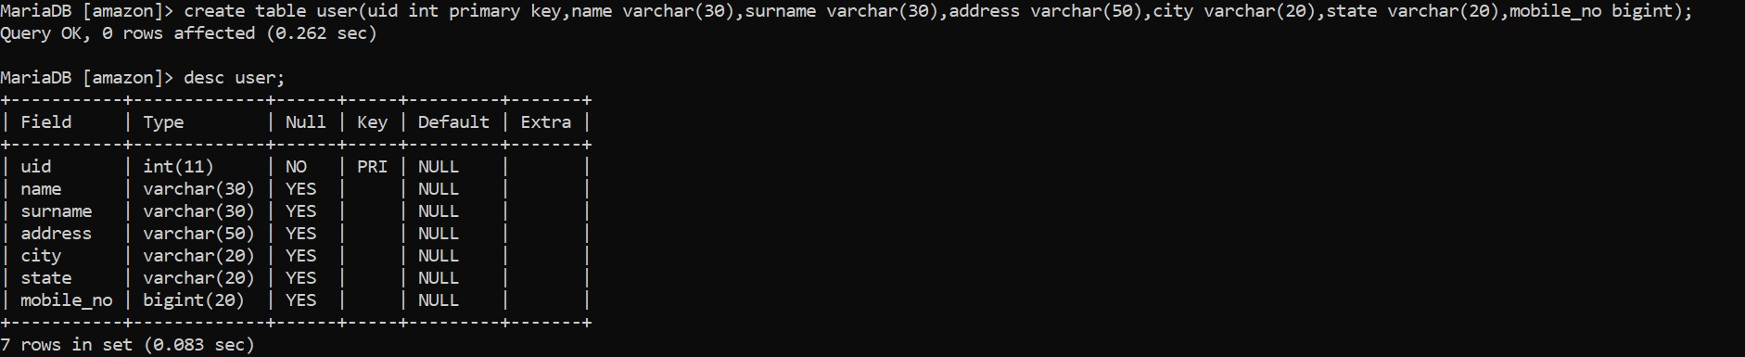
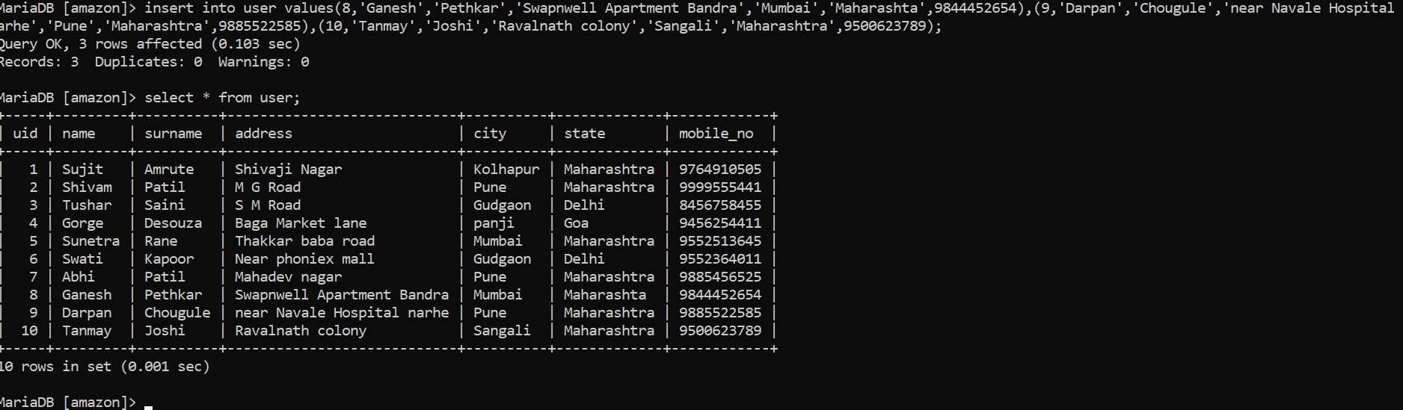
DDL (Data definition language)
Commands: create,alter,drop etc.
DML(Data manipulation language)
Commands: insert , update,delete .

Slide 4
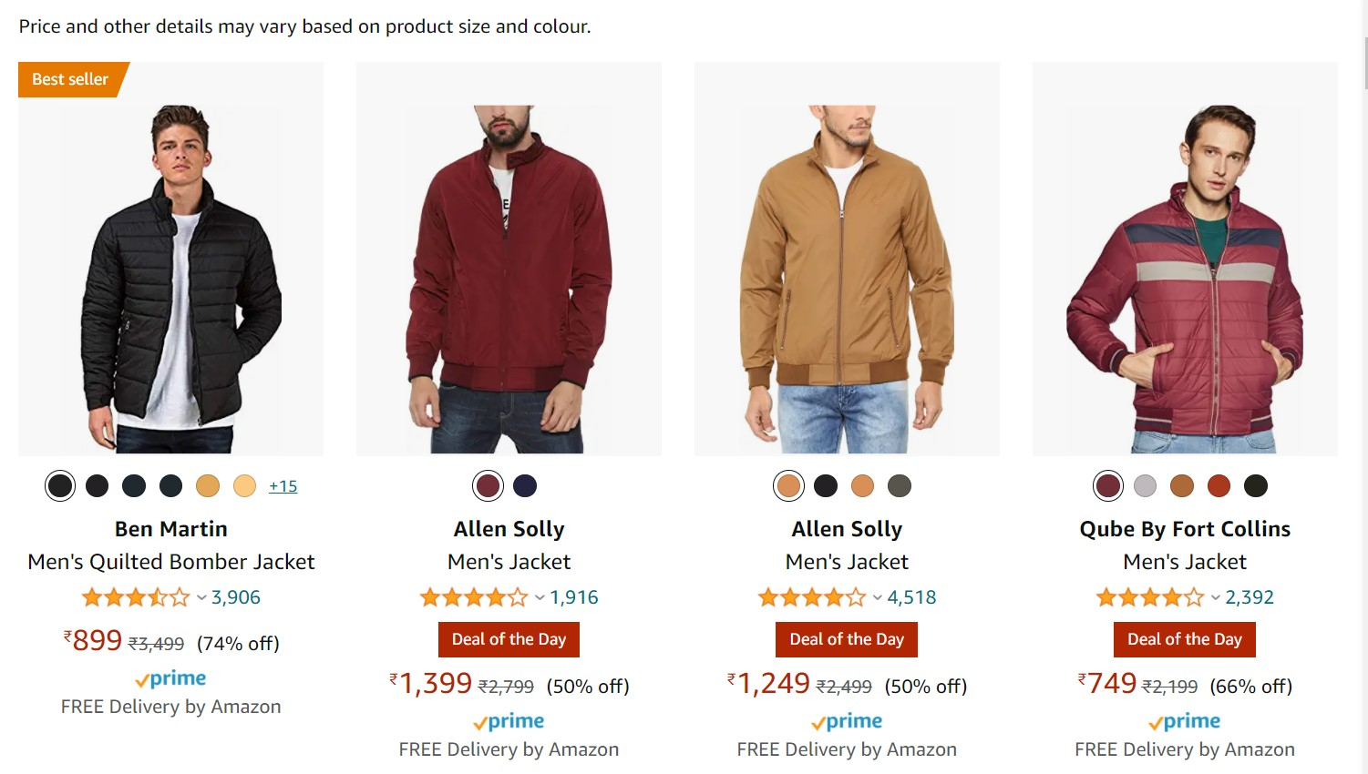
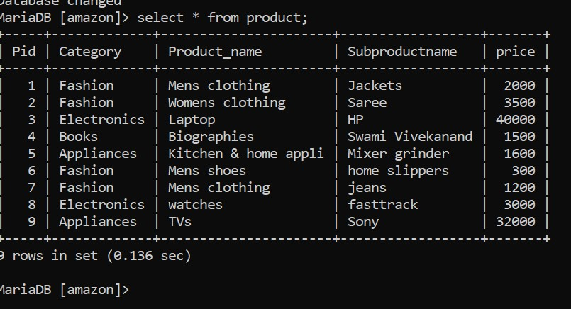
To see the product list :-
Syntax :- select * from product;

Slide 5
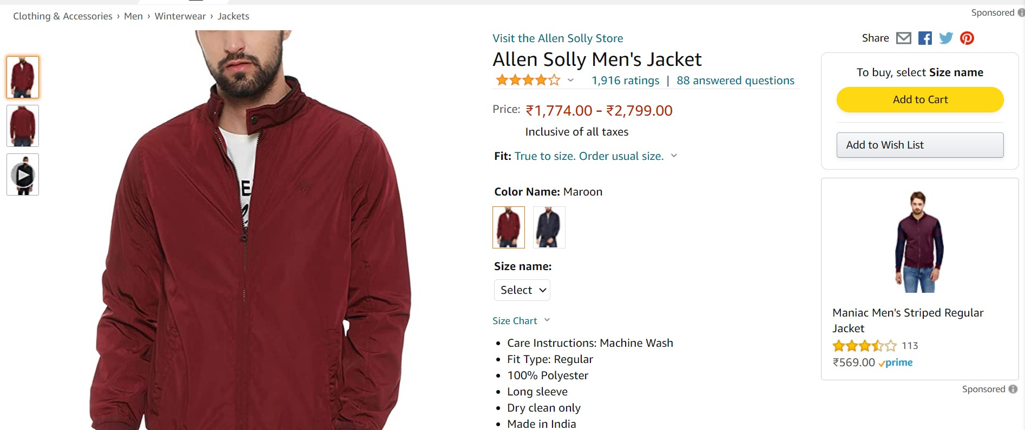
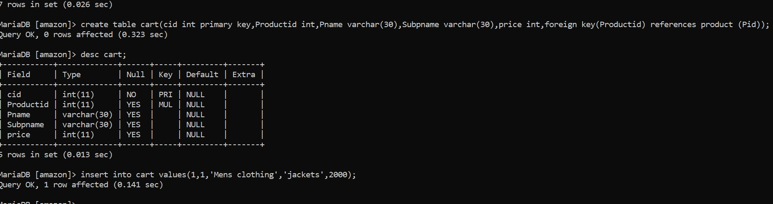
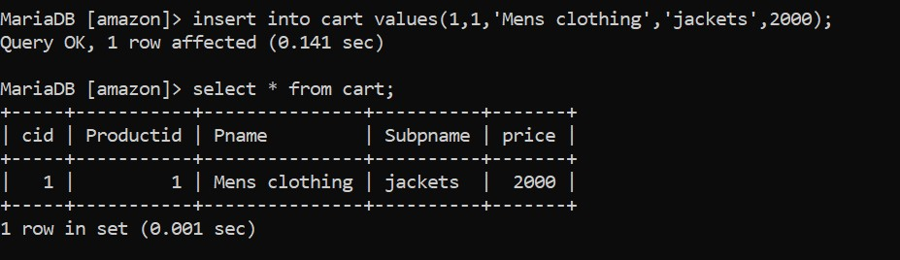
Primary key
Foreign key

Slide 6
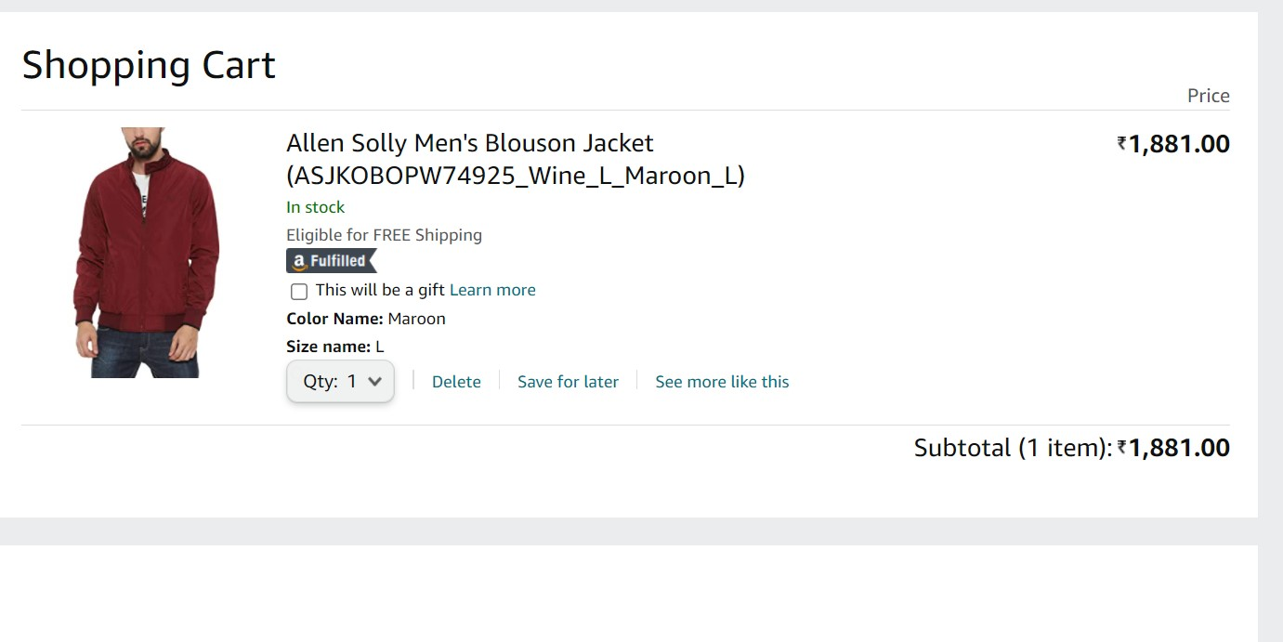
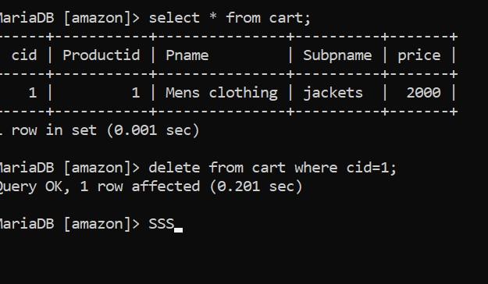
Delete statement :
delete from cart where cid=1;

Slide 7
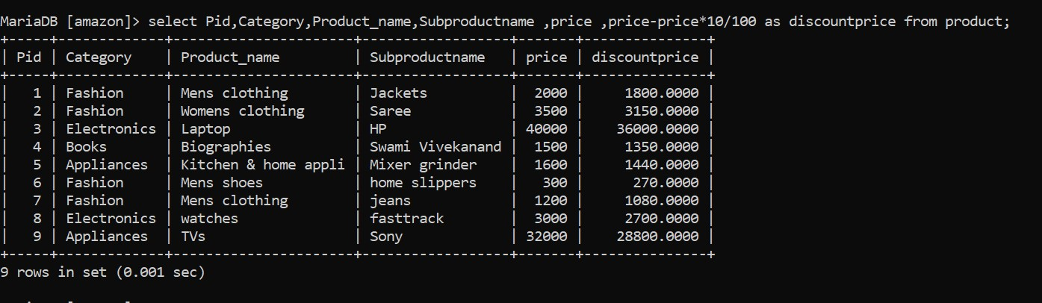
Aliasing : Give temporary name to column name.
select Pid, category,Product_name,subproductname,price,
price-price*10/100 as discountprice from product;

Slide 8
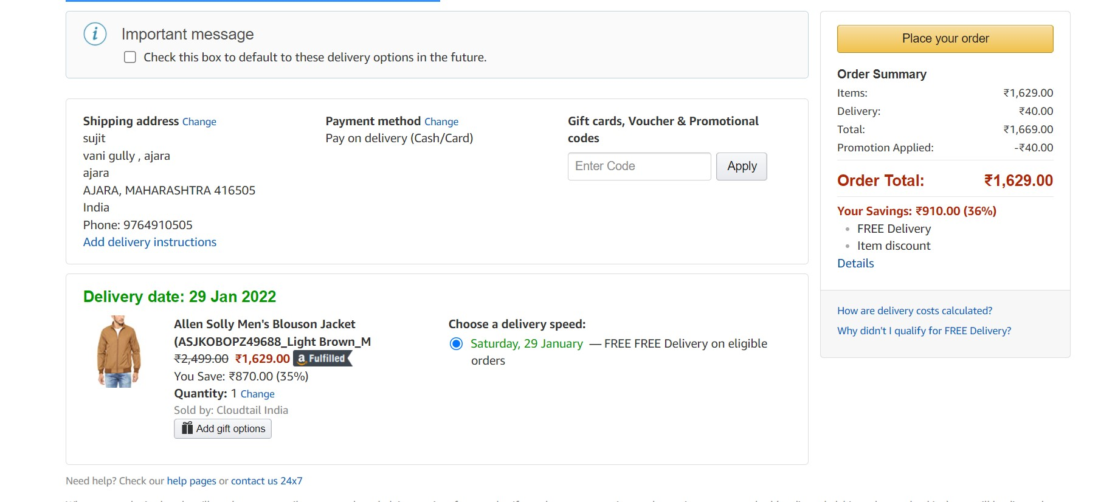
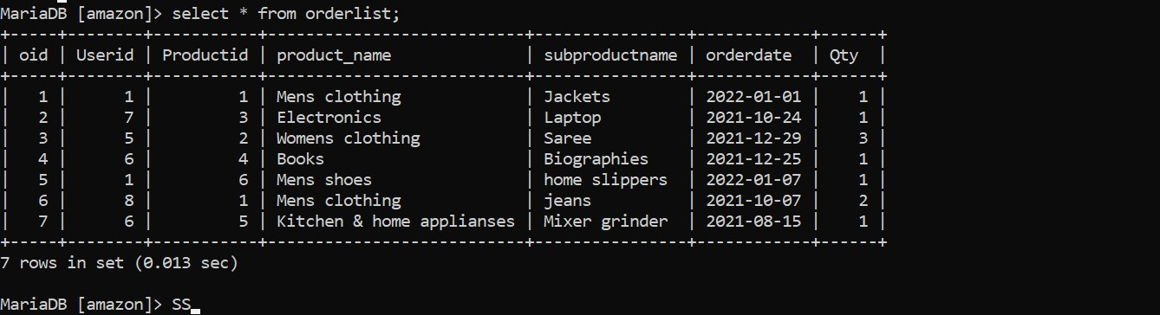
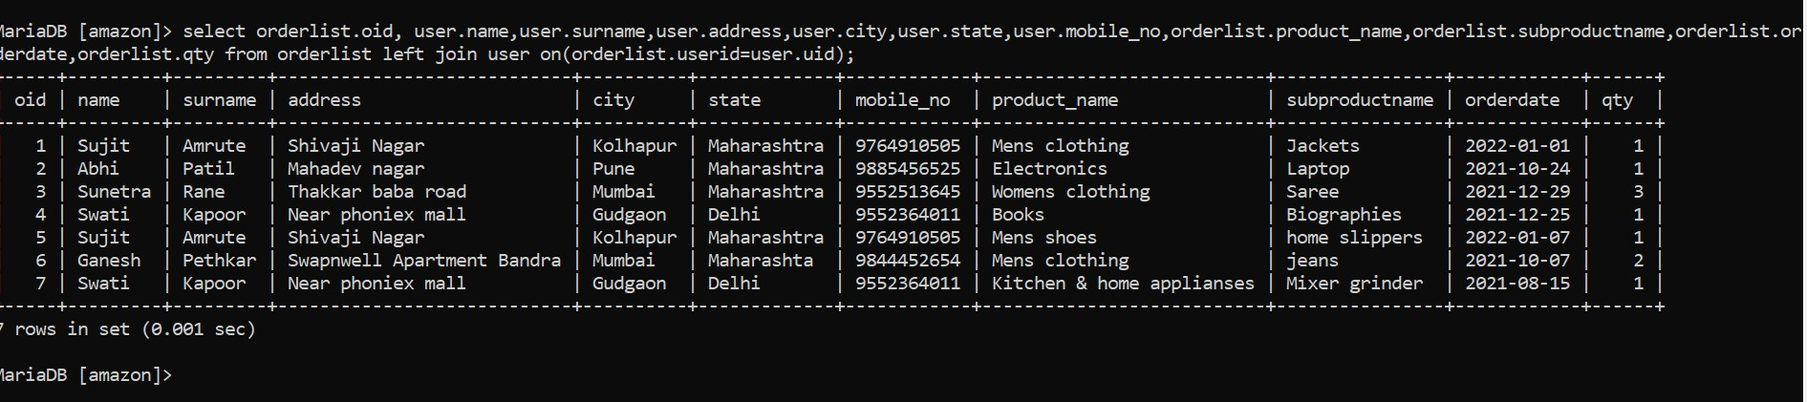
JOINS – If there is a need to fetch the records from two or more tables then we use join.

Slide 9
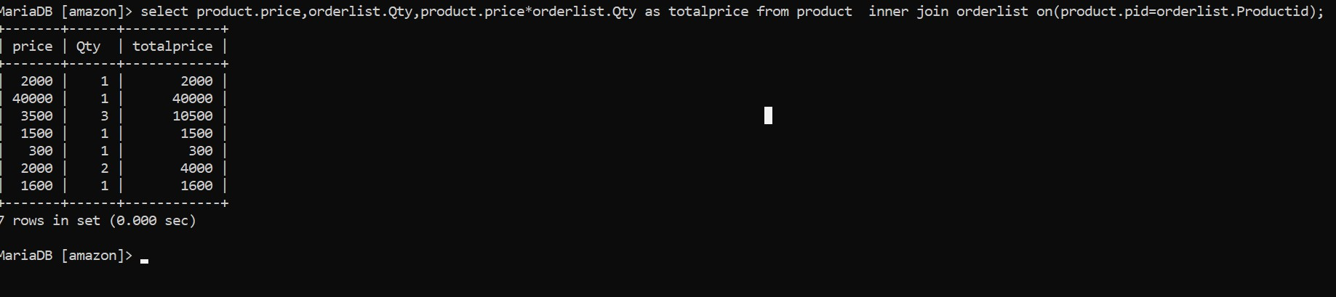
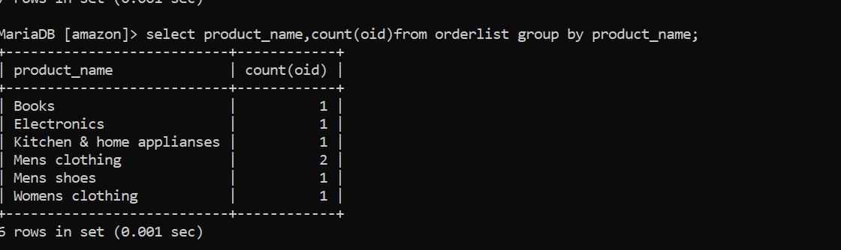
INNER JOIN :
GROUP BY CLAUSES :

Slide 10
THANK YOU

